Slide 1
Birmingham – Pride of Place
With a community inspired by place and connected by Community Passport

Slide 5
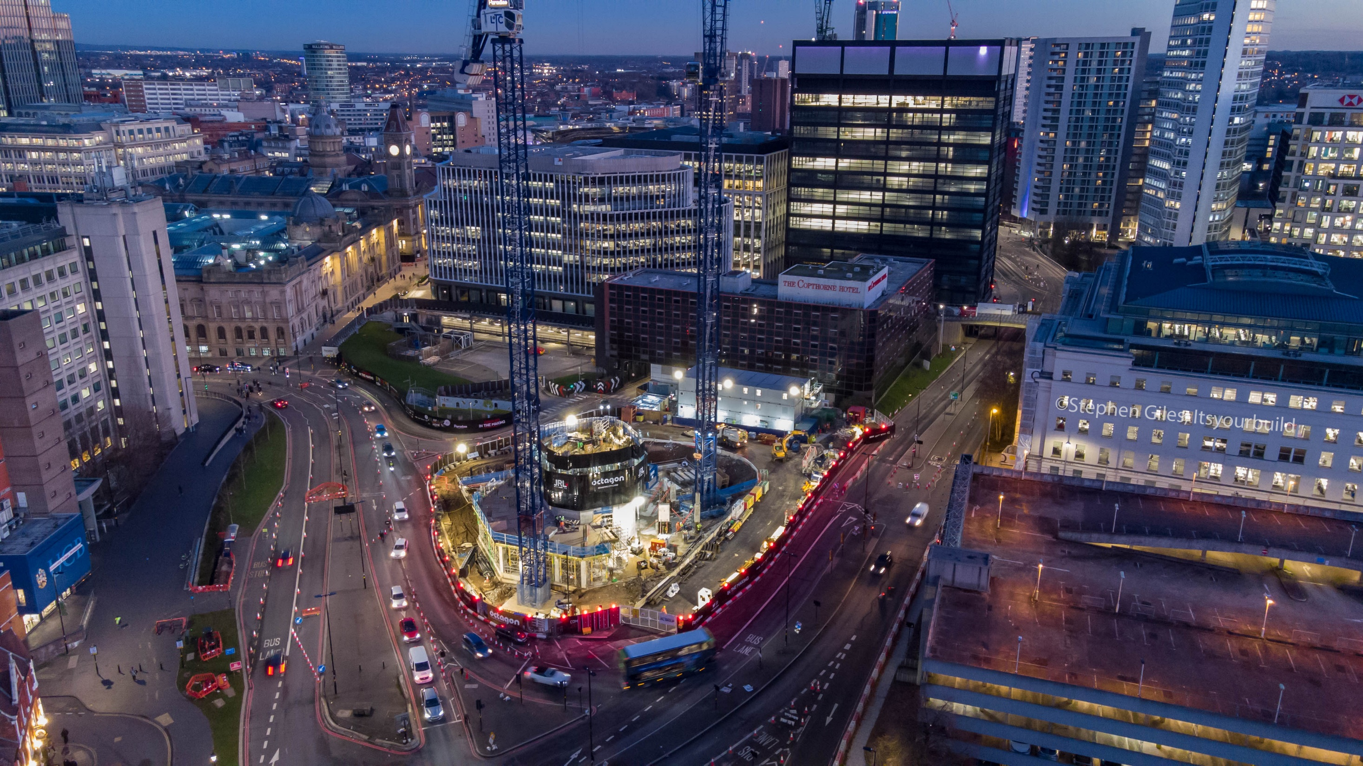

Slide 6
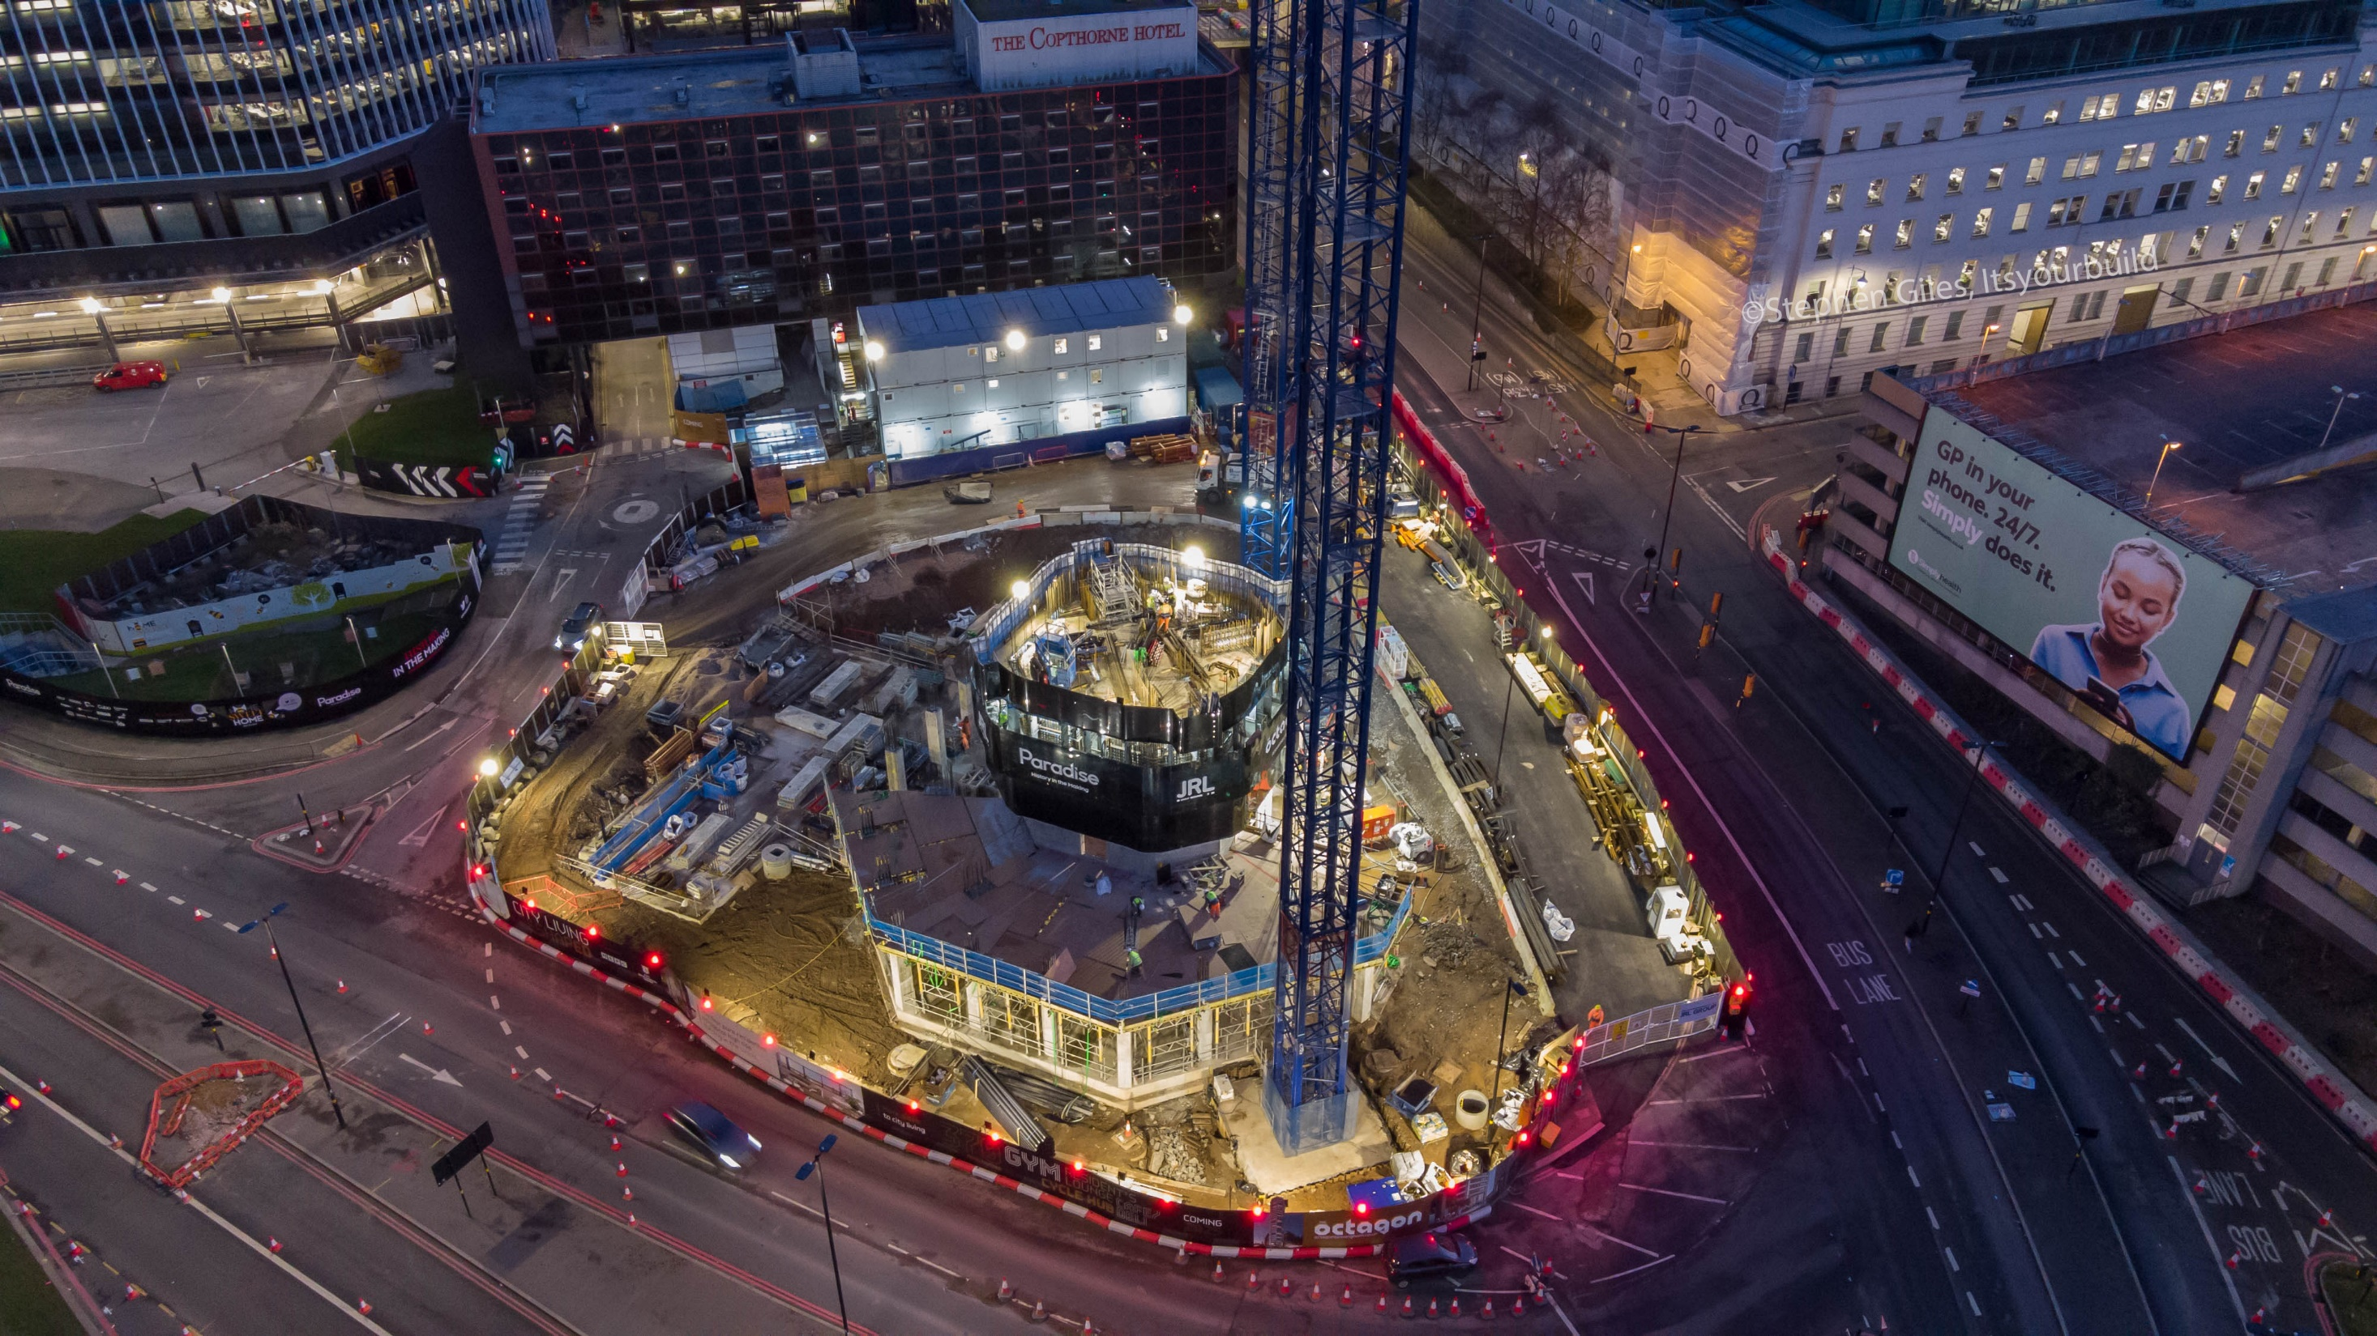

Slide 7
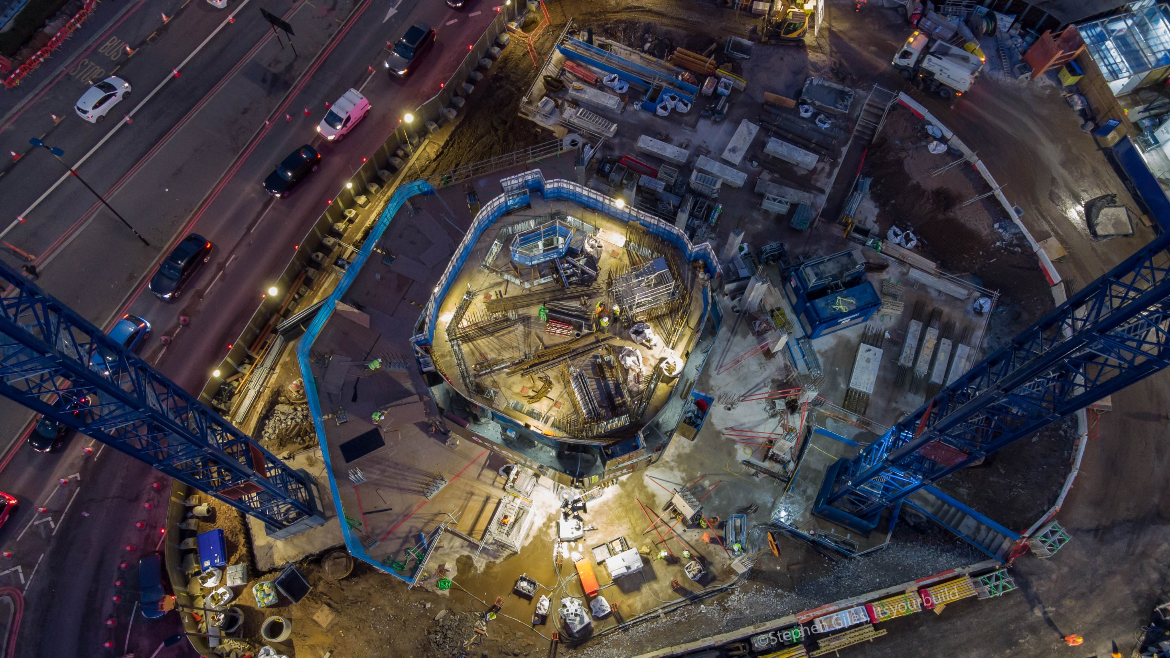

Slide 8
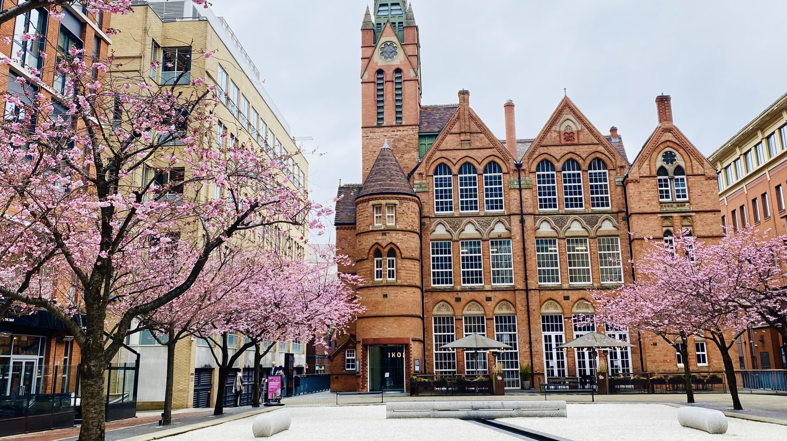

Slide 9
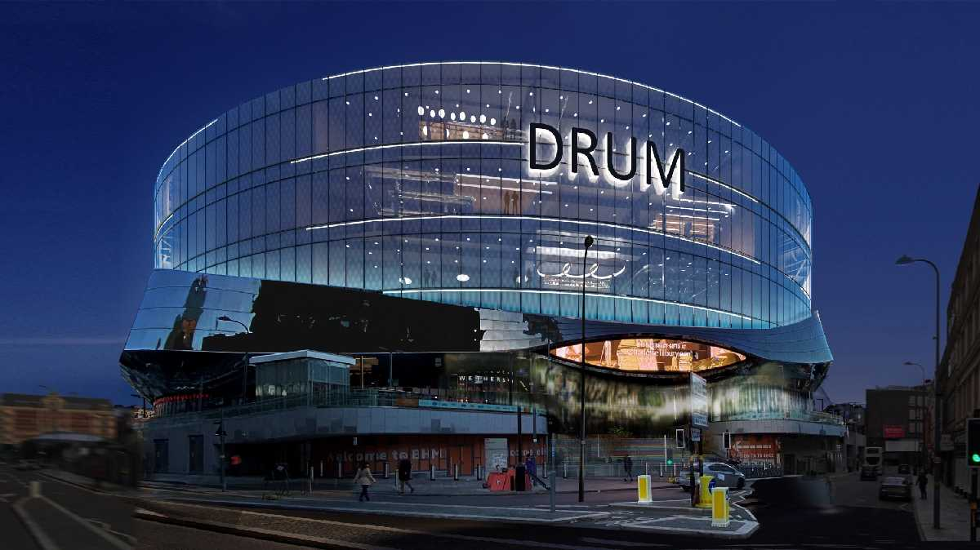

Slide 10
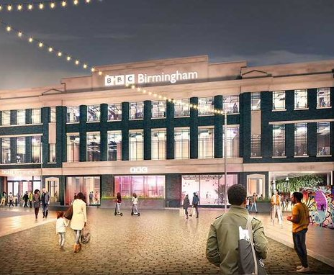

Slide 11
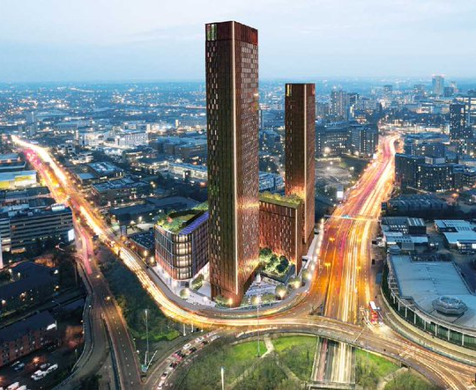

Slide 12
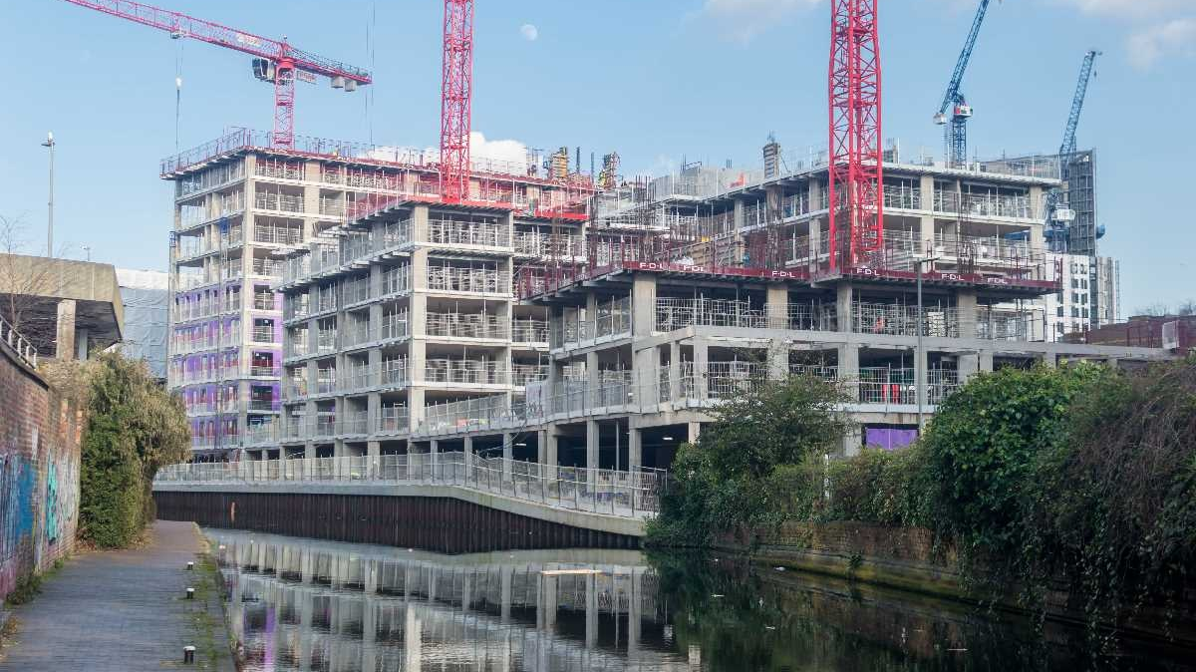

Slide 13
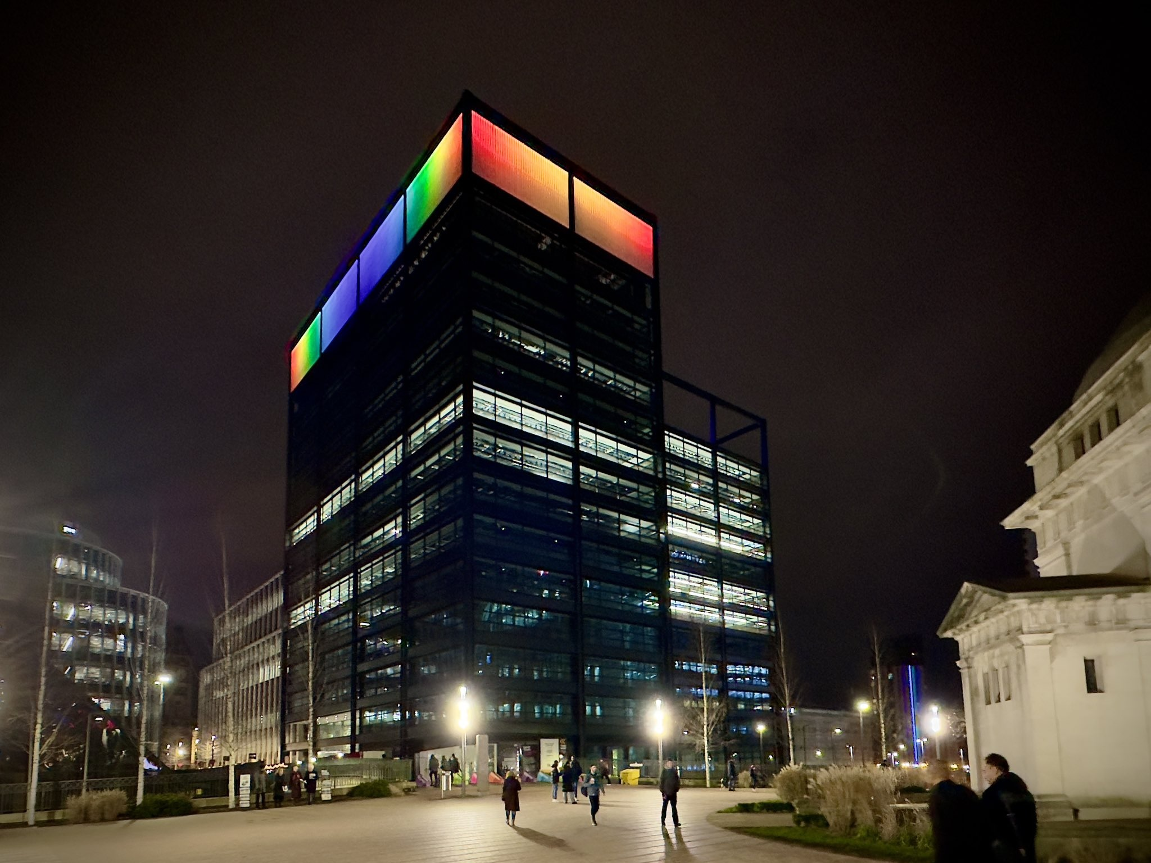

Slide 14
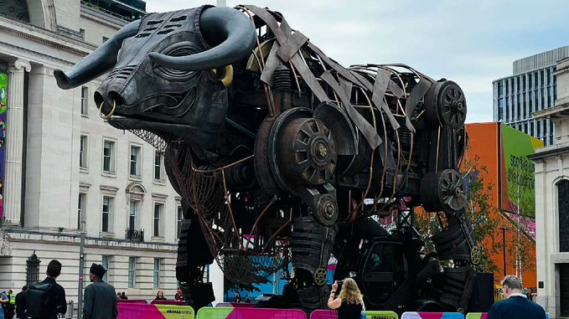

Slide 15
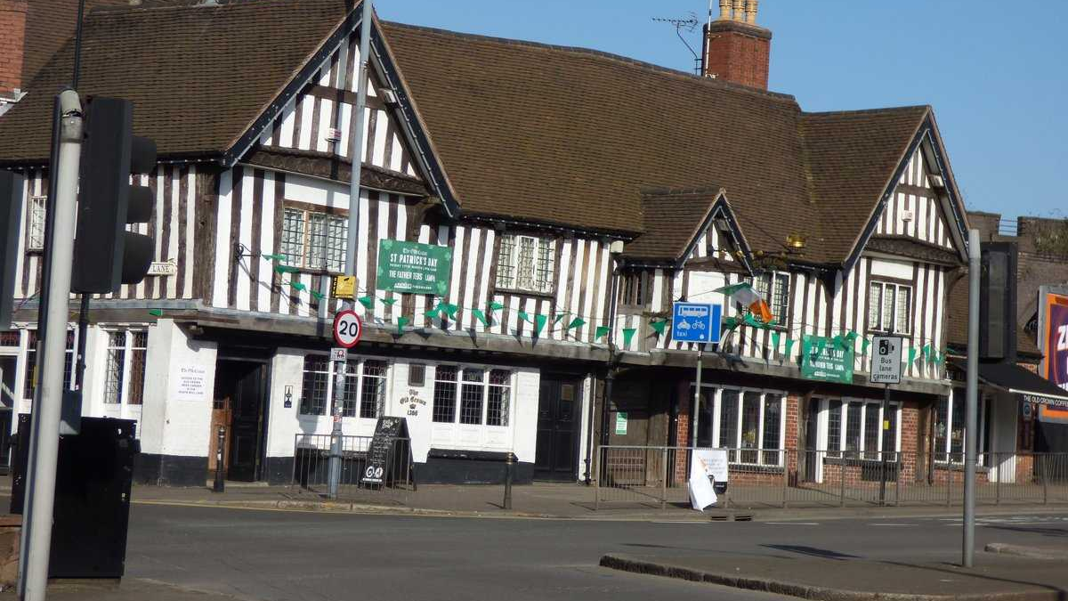

Slide 16
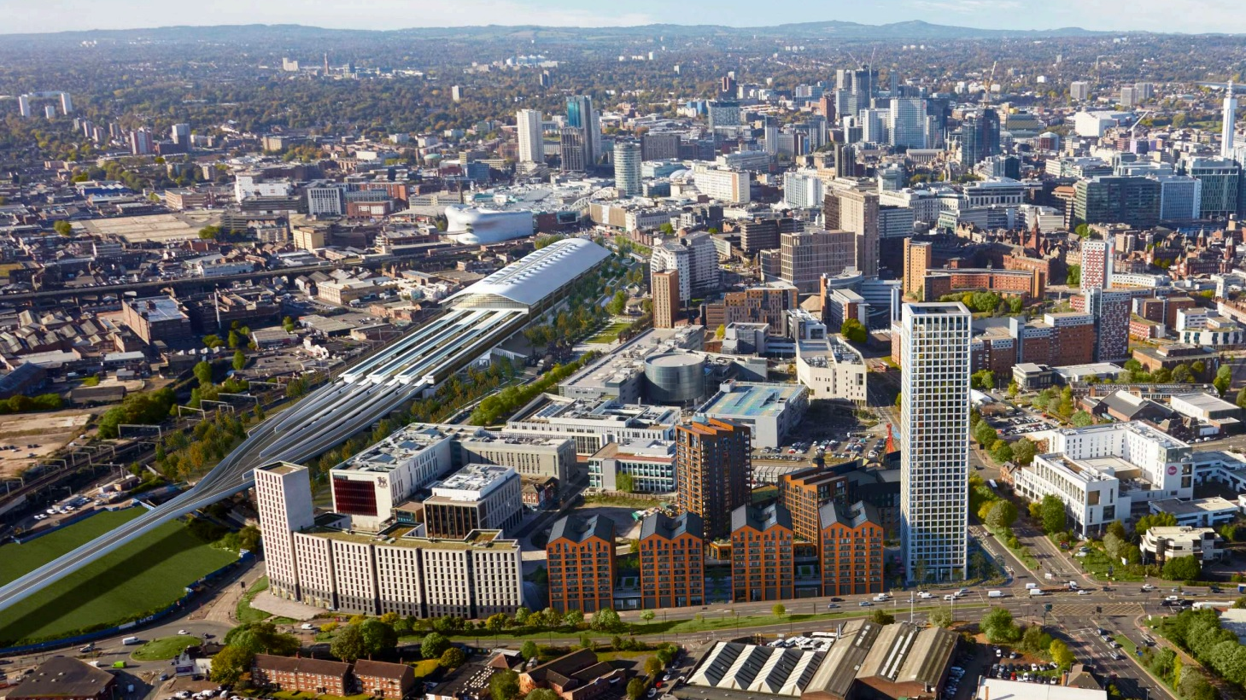

Slide 17
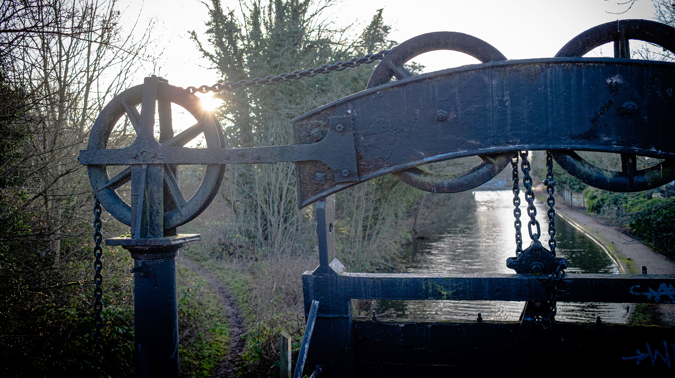

Slide 18
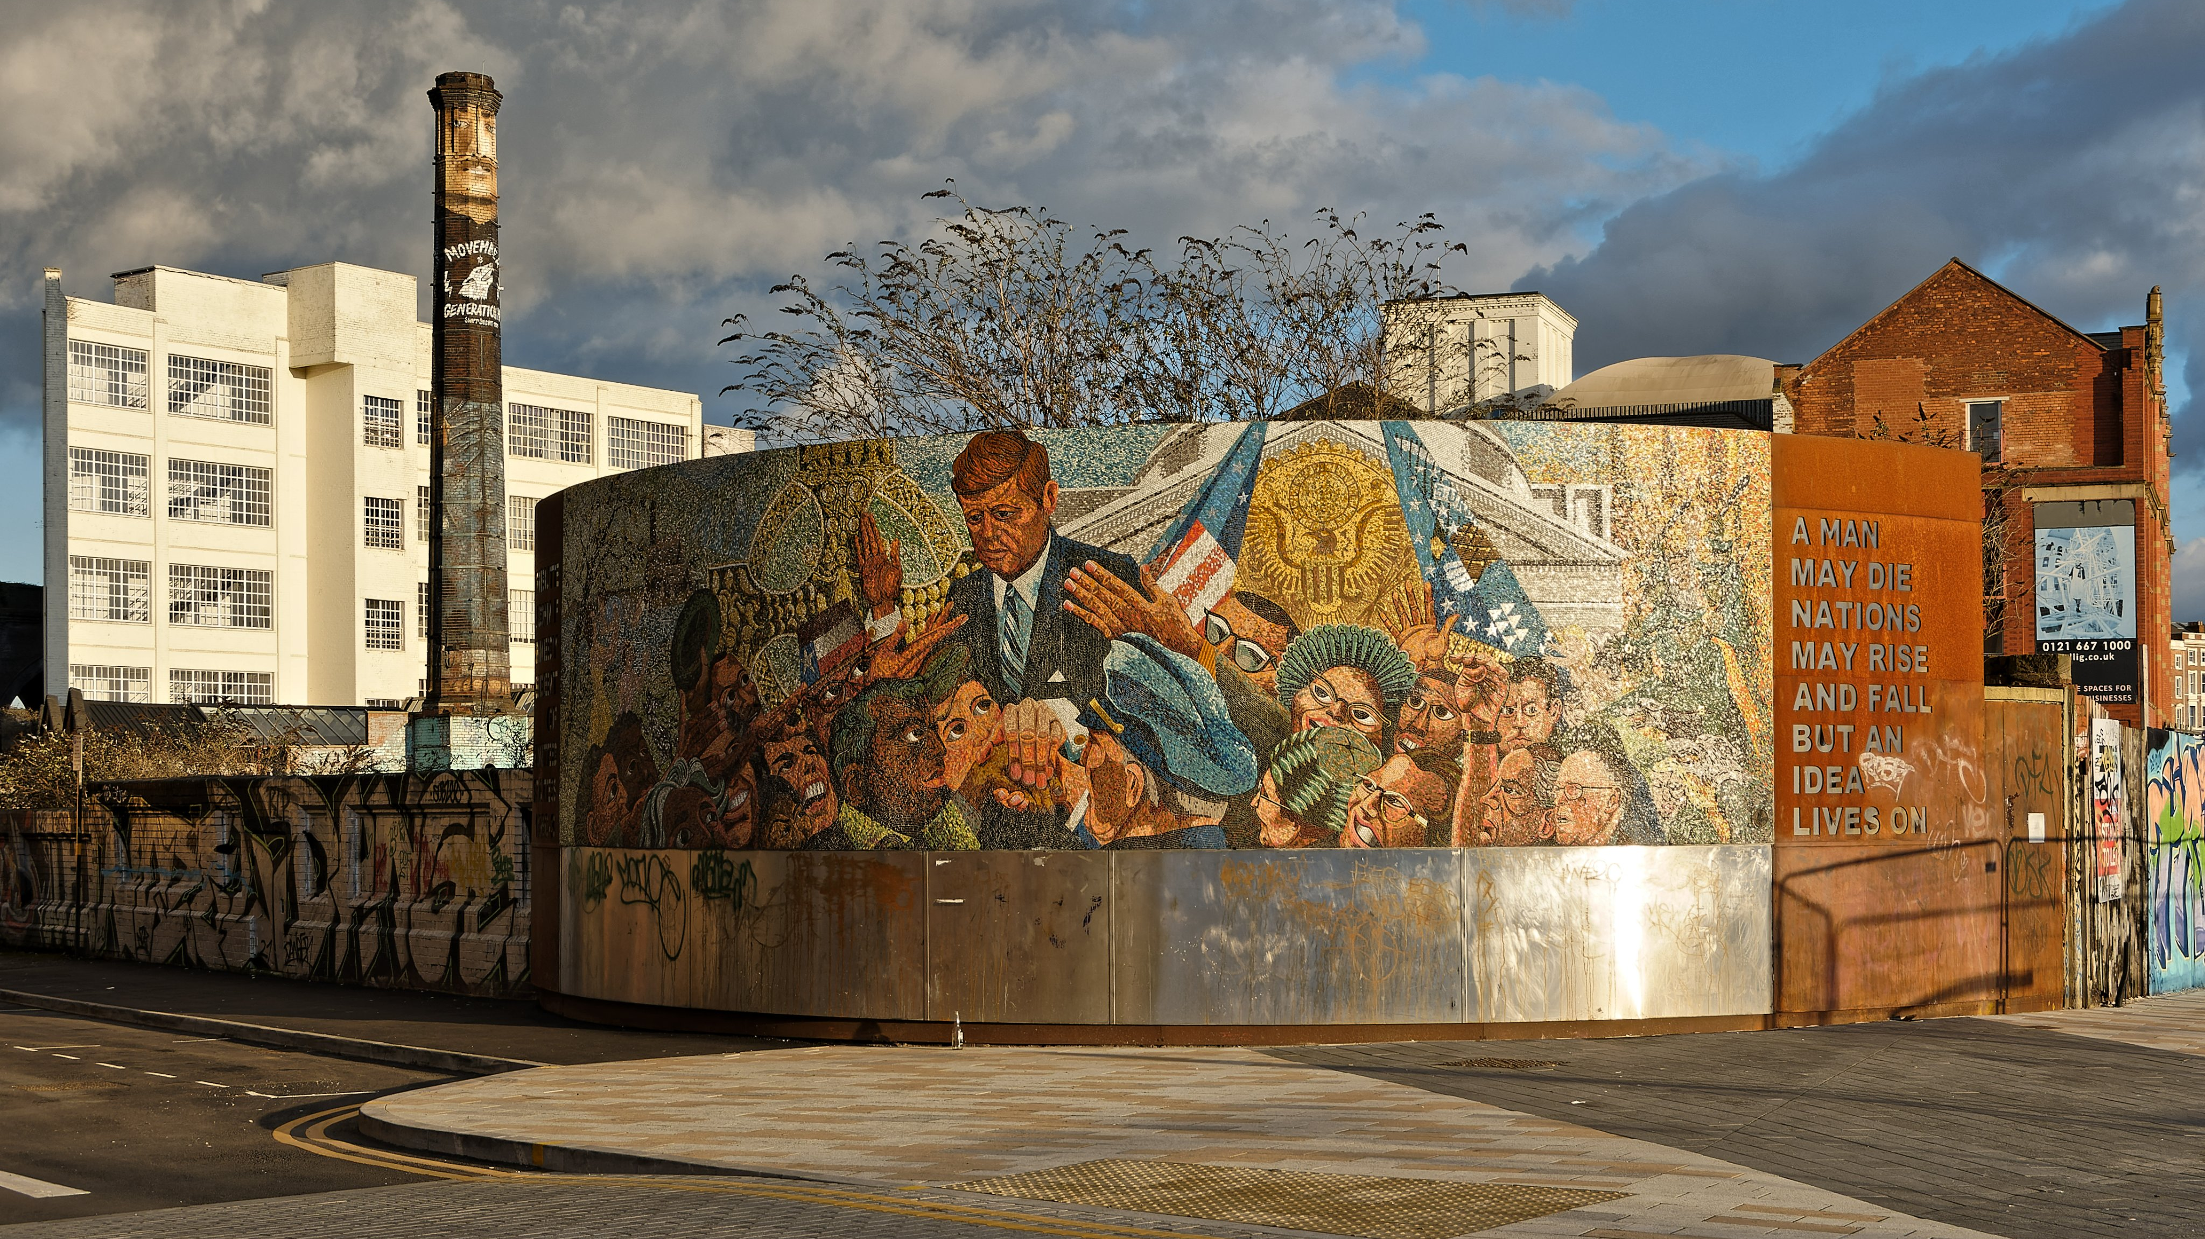

Slide 19
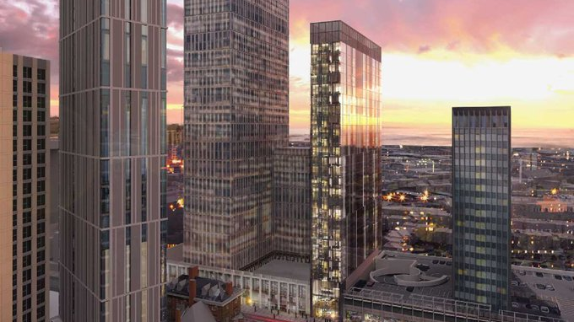

Slide 21
Contents
Building on the growing pride of Court Collaboration developments and Birmingham Gems
Let’s grow even more pride with Community Passport
Contact details

Slide 22
Build and share the pride in your developments – they’re all Birmingham Gems

Slide 23
Court Collaboration in Birmingham
Court Collaboration is without doubt a pioneering company helping to transform Birmingham with some quite amazing developments.

Slide 24
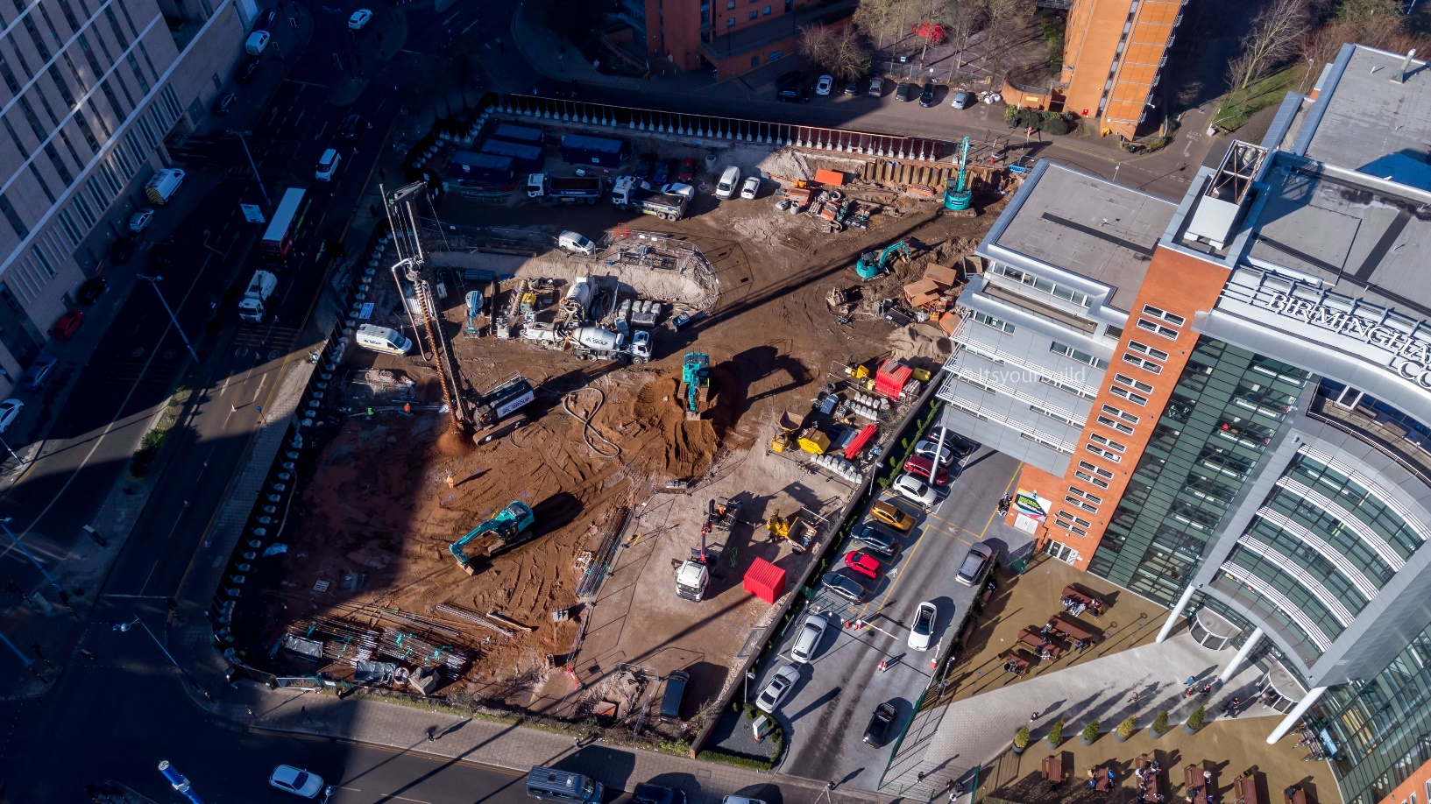
One Eastside from Court Collaboration is attracting loyal followers within our growing community

Slide 25
Your place-making journey at Court Collaboration is a journey that a growing number of people want to be part of. That’s where we come in. For many years, Your Place Your Space has provided people with a digital space and the tools required so that they can follow their Birmingham passions and their passion for the developments of Court Collaboration. A growing number of contributors are now creating content which we share and publish for those who follow all things Birmingham and all things construction.

Slide 26
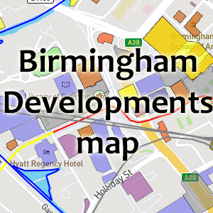
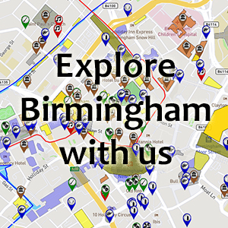
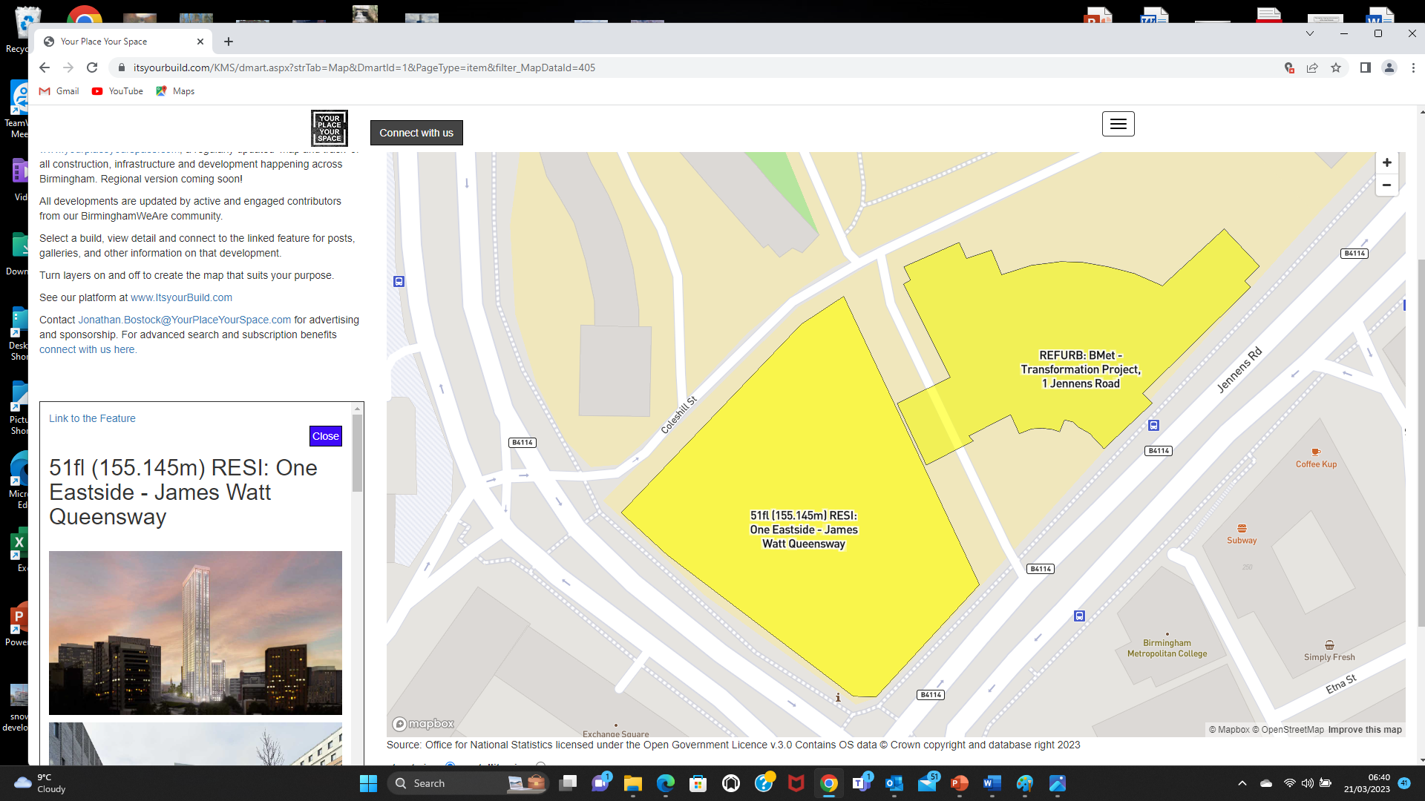
Content now appears on maps that have been viewed almost 2 million times since going live
Our interactive maps of Birmingham, the city’s gems and the city’s developments opens up a world of fascinating places that people can explore online and find out more about.

Slide 27
It’s so easy for people to explore your developments.
With so much community generated content
Regular articles and updates
Fantastic photography
Videos and drone footage
Trails, 360 degree tours, and even (coming soon) virtual reality
Augmented reality (Coming soon)
Links to web sites and social media
Simply click on a place of interest
Take the link to the feature
View content
Back to the map and view more

Slide 28
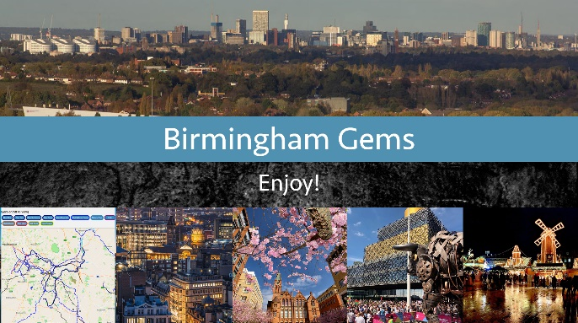
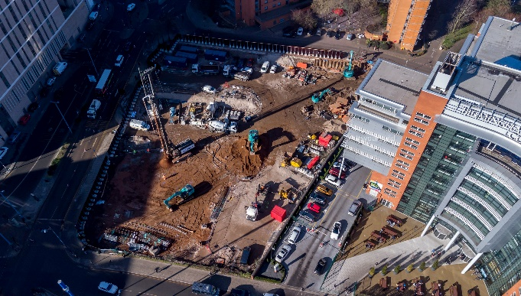
Regular content can now be shared and published across many platforms, websites and social media channels
www.itsyourbuild.com
www.birminghamGems.com
websites you host
social media
maybe a One Eastside community
social media you manage

Slide 29
This is all made possible by providing a digital space for contributors to share their Pride in Place. This space is called Community Passport.

Slide 30
Let’s grow even more pride in your builds with Community Passport

Slide 31
Community Passport is a digital space for people who just love to shape, make and promote places
Community
Passport

Slide 32
A digital space where people can access a suite of products and connect with people who share their passions
You are in: Community Passport You have access to:
Developments map
Birmingham Gems map
Community passport
Update your profile HERE
Community workspace
Welcome YourPlaceYourSpace
You have 28K points and contributed
27K points to your passions
Collect more points HERE
Manage resources
Resource library
Create feature
Your communities
Create post
Your resources
Mapping
Your features
Manage conversations
Surveys and polls
Your posts
Community
Passport
Help
guides
About
points
Our
sponsors
Our
partners
Contact
us

Slide 33
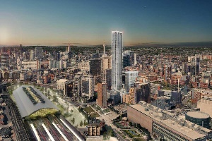
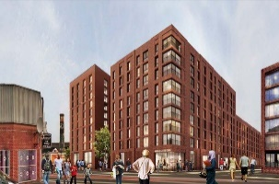
A digital space for contributors to come together and share a workspace containing unlimited features
Welcome to Community Workspace
One Eastside – Pride of Place View feature
Stone Yard – Pride of Place View feature

Slide 34
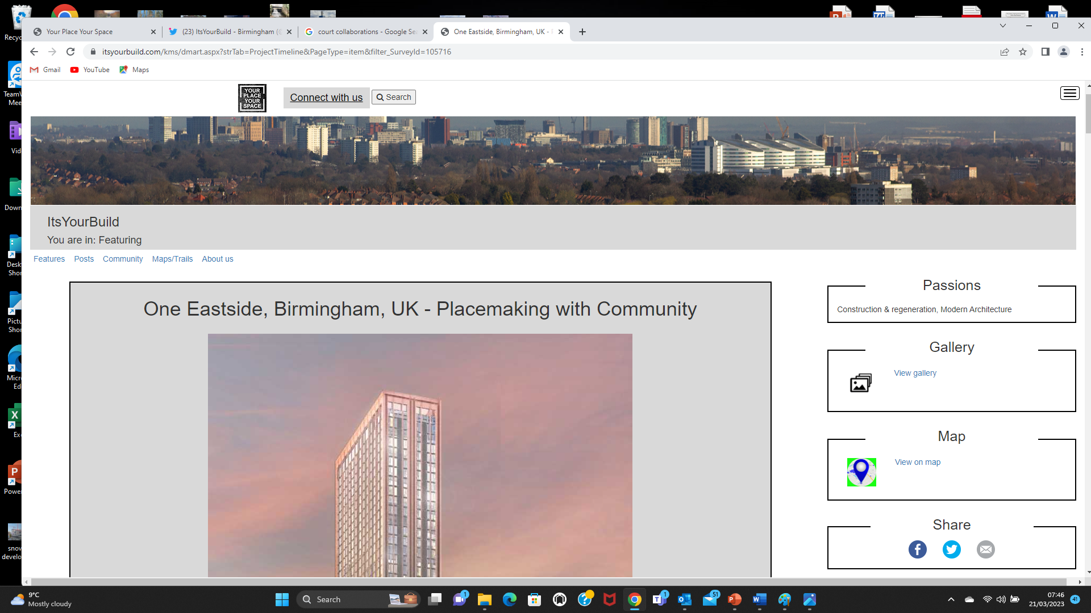
A digital space where people can access a growing suite of digital technology
creating maps
creating features
creating trails
creating digital experiences

Slide 35
A digital space where people can come together to share their passion for places they love in a safe on-line environment
Showcasing the best of History
Showcasing the best of Public Art

Slide 36
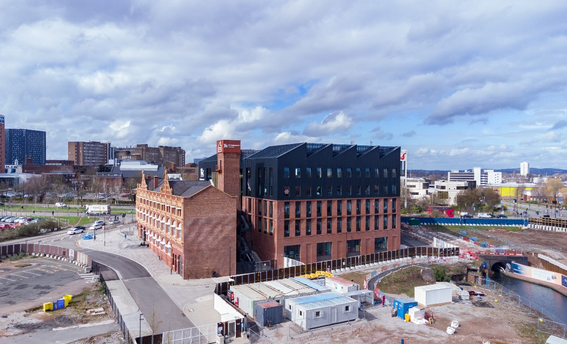
A digital space created with and for community, that is simply unlike any other.
Showcasing the best of Creativity
Showcasing the best of Architecture

Slide 37
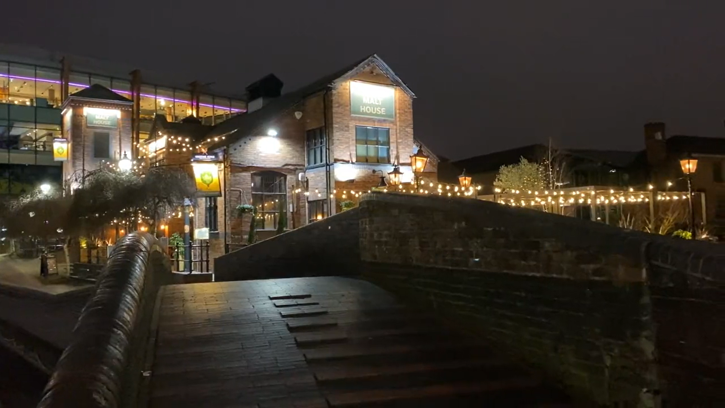
With a community that continues to capture and showcase the city’s gems on film with thousands of views
Here’s a community generated video viewed over 2,000 times
Here’s some footage of the canal viewed over 4,000 times

Slide 38
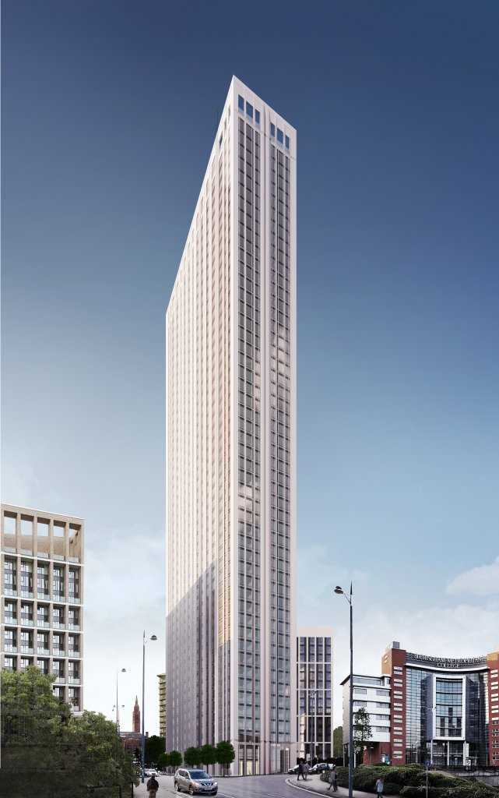
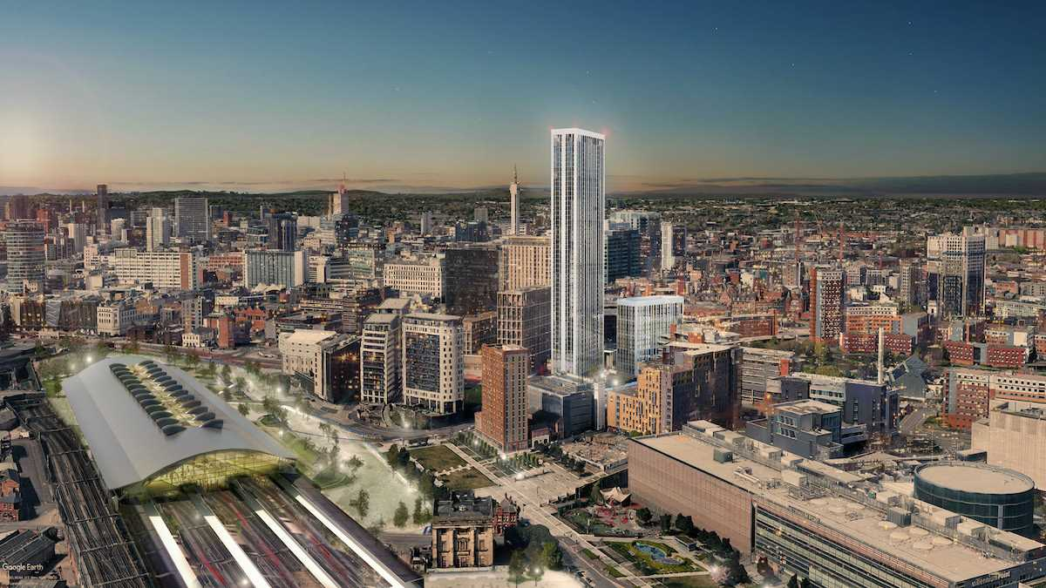
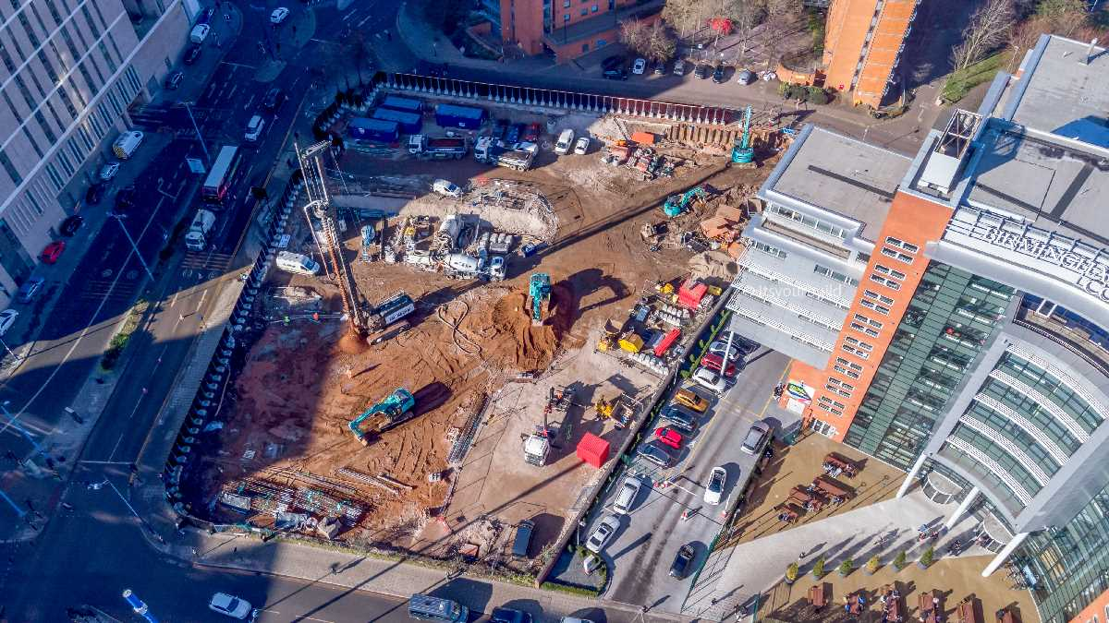
Let’s grow pride in your developments, regularly creating and sharing content with an engaged and inspired following.
Community
Passport

Slide 39
Let’s chat
e: Jonathan.Bostock@yourPlaceyourSpace.com m: 07432 637322

